Slide 1


Exercise Test in Informations Technology
http://schoolacademy.telerik.com
Training Test for IT Olympiad (NOIT)
Douglas Adams
Telerik Software Academy
academy.telerik.com

Slide 2
Douglas Adams
Simon Kazakov
Gergana Kechova
Delyan Nikolov
Neven Dyulgerov
Dimitar Marinov
Katerina Serafimova
Yasen Stoyanov
Angel Dyankov
Stefan Neshterev
Stefan Stefanov
Viktor Draganov

Slide 3
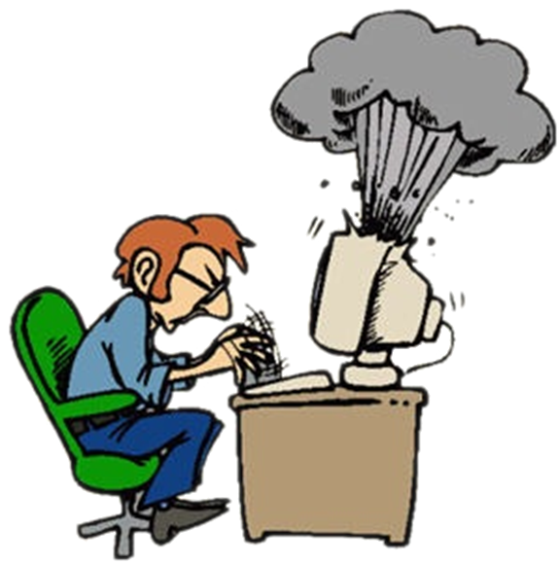

Computer Systems
Hardware Questions

Slide 4
Question
What is NOT true about Northbridge (can have more than one answer)
Northbridge is connected though “PCI bus” to the “Onboard Graphics Controller”
Northbridge plays an important part in overclocking.
Used to manage data communication between a CPU and a motherboard.
He is connected though “Internal bus” with Southbridge

Slide 5
Answer
Answer: A
Southbridge provides that connection, as the connection to the PCI slots. Northbridge connects with the Graphics card slot (High-speed graphics bus – AGP or PCI-Express)
Information:
http://en.wikipedia.org/wiki/Northbridge_(computing)

Slide 6



Software Systems
Computer Software

Slide 7
Question
Which of the following programming languages ​​is non object-oriented?
C#
Python
Ruby
Pascal
Java
All of the above are object-oriented programming languages

Slide 8
Answer
Answer: E
Pascal is non object-oriented programming language, but later the object-oriented version Object Pascal was developed.
C#, Python, Ruby and Java are object-oriented programming languages.
Information:
http://en.wikipedia.org/wiki/Pascal_(programming_language)
http://en.wikipedia.org/wiki/List_of_object-oriented_programming_languages

Slide 9
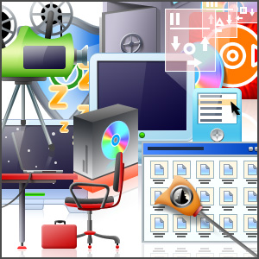

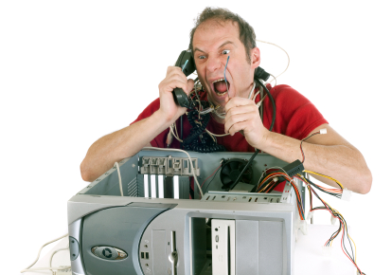
Working with Computer Systems and Programs
Installation, Use, Maintenance, …

Slide 10
Question
What is Computer Base Score in Windows 7 OS?
The capability of your computer's hardware and software configuration expressed as a number.
The result of tests run on the RAM hardware components of your computer.
The result of tests run on the CPU hardware components of your computer.
The result of tests run on the gaming graphics hardware components of your computer

Slide 11
Answer
Answer: A
The capability of your computer's hardware and software configuration expressed as a number.
Information:
http://windows.microsoft.com/en-us/windows/what-is-windows-experience-index#What-is-windows-experience-index=windows-7

Slide 12

Data Transmission and Numeral Systems
Data Transmission Channels, Measurement Units, Working with Numeral Systems

Slide 13
Question
How much is FА₍₁₆₎ – 10001011₍₂₎?
АG₍₁₆₎
111₍₈₎
157₍₁₀₎
111 ₍₁₆₎
157₍₈₎
110111₍₂₎

Slide 14
Answer
Answer: E
Arithmetic operations with numbers are calculated easier in decimal numeral system:
FA₍₁₆₎ = 250₍₁₀₎
10001011₍₂₎ = 139₍₁₀₎
250₍₁₀₎ – 139₍₁₀₎ = 111₍₁₀₎
Simple transformations lead to the answer.
AG₍₁₆₎ is not a valid number.
Information:
http://en.wikipedia.org/wiki/Numeral_system

Slide 15





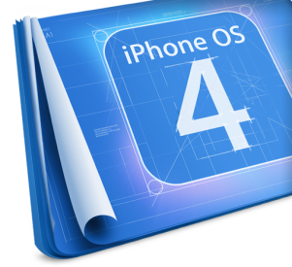


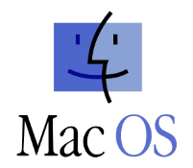





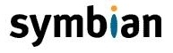
Operational systems
Architecture, Processes, Users, User Interface, File Systems

Slide 16
Question
Which of the following is a multi-user operating system?
Unix
Windows 95
Windows 2000
Mac OS
Palm OS
FOXP3

Slide 17
Answer
Answer: A
FOXP3 is a protein and the rest of the listed OS are single-user.
Some OS such as Windows 2000 can support lots of networked users, but then the only "user“ is the system administrator.
Information:
http://computer.howstuffworks.com/operating-system3.htm

Slide 18
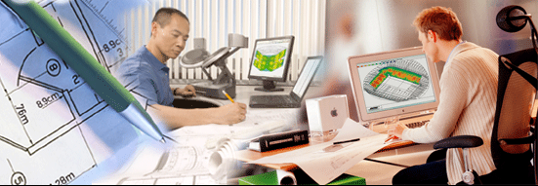
Software Engineering
Analysis, Specifications, Projecting, Prototype, Implementation, Testing, Maintenance, …

Slide 19
Question
Which of the following tests focuses on finding defects after a major code change has occurred?
Smoke testing
Sanity testing
Regression testing
Acceptance testing
Functional testing
Non-functional testing

Slide 20
Answer
Answer: C
Regression testing seeks to uncover new software bugs in a system after changes such as enhancements, patches or configuration changes.
Information:
http://en.wikipedia.org/wiki/Software_testing
http://en.wikipedia.org/wiki/Regression_testing

Slide 21


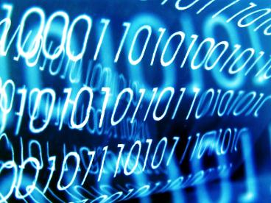
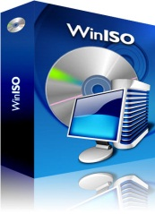
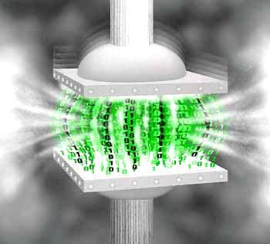




Data Compression
Compression Algorithms, Data File Compression Software

Slide 22
Question
The Huffman compression algorithm replaced the Shannon-Fano algorithm. Both use a “tree” as a visual representation. Is there a difference between the two methods and if yes, what is it?
The Shannon-Fano algorithm starts from the leaves towards the roots of the “tree”, whereas the Huffman algorithm starts from the roots towards the leaves.
The Shannon-Fano algorithm starts from the roots towards the leaves of the “tree”, whereas the Huffman algorithm starts from the leaves towards the roots.
Both methods start from the leaves towards the roots.
Both methods start from the roots towards the leaves.

Slide 23
Answer
The Shannon-Fano algorithm starts from the roots towards the leaves of the “tree”, whereas the Huffman algorithm starts from the leaves towards the roots.
They are both compression algorithms. Shannon-Fano is an efficient method, but is not optimal. Created 4 years later the Huffman method replaced it completely, due to it being always optimal (uses the least amount of computer resources).
Information:
Shannon-Fano: http://www.cs.cf.ac.uk/Dave/Multimedia/node209.html
Huffman: http://www.webopedia.com/TERM/H/Huffman_compression.html

Slide 24



Text Processing
Work with Text Processing Software, File Formats, Encodings, Text, Tables, Figures, …

Slide 25
Question
Which of the following text formats CANNOT containt images?
.rtf (Rich Text Format)
.odt (OpenDocument Text)
.doc (Microsoft Word Document)
All of the above formats CAN contain images

Slide 26
Answer
Answer: D
All of the aforementioned text formats can contain an image aswell as text formatting
Infromation:
.rtf http://en.wikipedia.org/wiki/Rich_Text_Format
.odt http://en.wikipedia.org/wiki/OpenDocument
.doc http://en.wikipedia.org/wiki/.doc

Slide 27
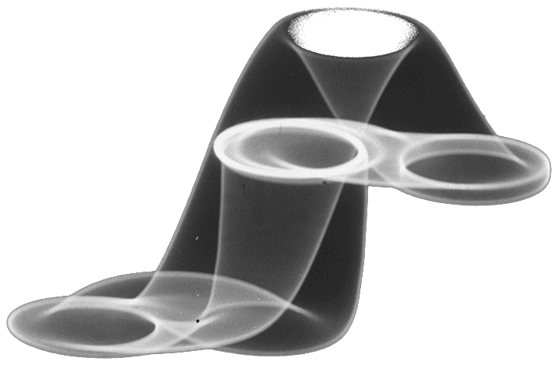



Computer Graphics
Raster and Vector Graphics, Image File Formats, Graphics Editors, Color Schemes

Slide 28
Question
What does tessellation do?
Increases texture fill rates
Dynamically increases polygon counts
Improve perceived texture quality
Enhancing the image quality of textures on surfaces
None of the above

Slide 29
Answer
Answer: E
Tessellation is a relatively new technique that most modern graphic cards support. It is well-known for placing a significant load on most GPUs.
Tessellation I graphics cards is used to add more polygons to a scene, thus improving detail.
Information:
http://en.wikipedia.org/wiki/Tessellation_(computer_graphics)

Slide 30
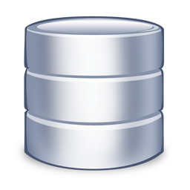
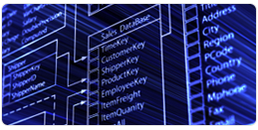


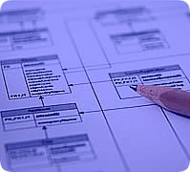

Databases
Models, Tables, Relations, SQL

Slide 31
Question
Which of the following is the most commonly used type of database system model?
Hierarchical database model
Network model
Relational model
Object oriented model
Associative model
Document - oriented model

Slide 32
Answer
Answer: C
A relational database is a database that has a collection of tables of data items, all of which is formally described and organized according to the relational model.
Information:
http://en.wikipedia.org/wiki/Relational_database

Slide 33

Information Systems
ERP, CRM, BI, BPM, FMIS, CAD/CAM, CMS, Software Architectures

Slide 34
Question
Which class infromation systems has these typical functions: organizing technical support, sales monitoring and organizing marketing campaigns?
CAD
CRM
ERP
RDBMS
None of the above

Slide 35
Answer
Answer: B
Customer Relationship Management (CRM) systems:
Organize and track the communication with the clients, the service and the support
Organize the sales process
Organize the marketing process
Information:
http://en.wikipedia.org/wiki/Customer_relationship_management

Slide 36


Inforamation Security and Protection
Symmetric and Asymmetric Encoding Algorithms, Hashing with Cryptographic Hash Functions, Digital Signature, Digital Certificates

Slide 37
Question
Which construction is 3DES ?
Е(к3) (D(к2)(Е(к1)))
Е(к3) (E(к2)(Е(к1)))
Е(к1) (D(к2)(D(к3)))
Е(к3) + D(к2) + Е(к1)
Е(к1) (D(к2)(Е(к3)))
Е(к1) + E(к2) + Е(к3)
Е(к) – Encrypt; D(к) – Decrypt;

Slide 38
Answer
Answer: A
Triple DES is the common name for the Triple Data Encryption Algorithm (TDEA or Triple DEA)
Triple DES carefully executes (DES) 3 times with different keys
Information:
http://en.wikipedia.org/wiki/Triple_DES

Slide 39




Presentations Systems
Presentation Software, Making Presentations, Slides, Effects, Notes, Colors, Images, Sound, Video

Slide 40
Question
Which of the following would you use to make a .PPT presentation, without having any presentation software installed:
Microsoft Word
Microsoft Power Point
Google Docs
Eclipse

Slide 41
Answer
Answer: C
Google Docs is a web-based software which can be used for making .PPT presentations.
Information:
http://www.wikihow.com/Make-a-PowerPoint-Presentation-Without-PowerPoint

Slide 42
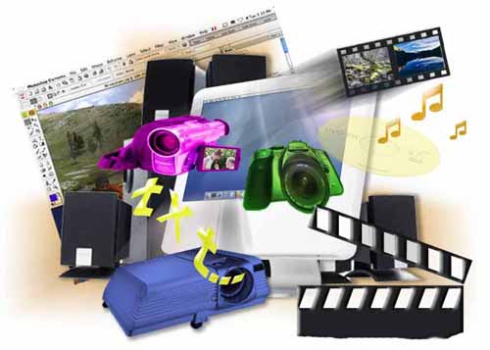
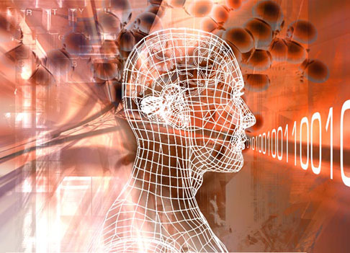
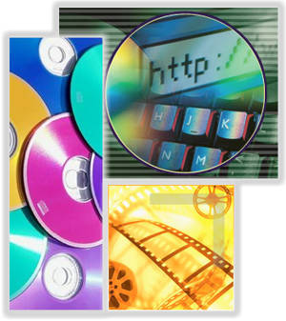

Multimedia
Software for Multimedia Creation / Processing: sound, video, file formats

Slide 43
Question
Which of the following is a media player and is not a Microsoft product:
Media Player Classic
Audacity
QuickTime
Flash Player

Slide 44
Answer
Answer: C
QuickTime is a media player which is an Apple product.
Information:
http://en.wikipedia.org/wiki/Adobe_Flash_Player
http://en.wikipedia.org/wiki/Audacity
http://en.wikipedia.org/wiki/Media_Player_Classic
http://en.wikipedia.org/wiki/QuickTime

Slide 45
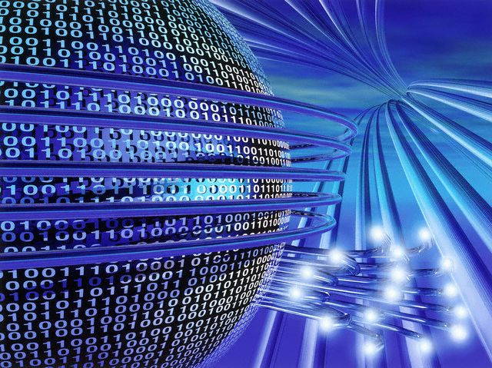
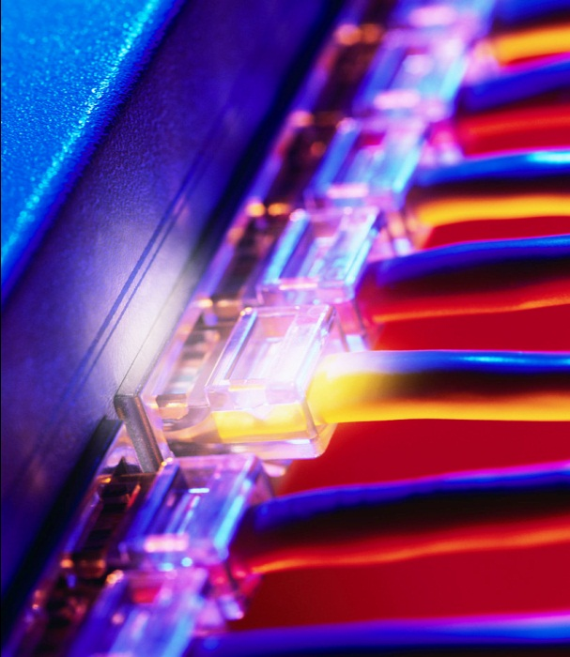
Computer Networks
OSI model, Network Models, Protocols, Standards, Hardware Equipment

Slide 46
Question
What VPN (Virtual Private Network) is:
Connection between a client and server through a proxy server.
File transfer from one host to another.
Connection to public network (Internet) that provides authorization and encryption.
Public connection between two computers.

Slide 47
Answer
Answer: C
Connection to public network (Internet) that provides authorization and encryption.
Information:
http://pcworld.bg/12368_shto_e_to_vpn

Slide 48
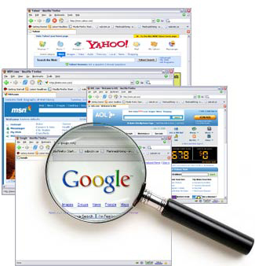


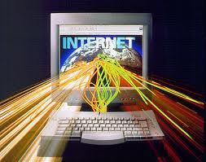
Internet
Internet, Protocols, Services, WWW, HTTP, FTP, SMTP, POP3, IMAP, WebDAV, IP, DNS, …

Slide 49
Question
Select the correct answer:
It is possible one DNS name to corresponds to several IP addresses but it is not possible one IP address to corresponds to several DNS names.
It is possible one IP address to corresponds to several DNS names but it is not possible one DNS name to corresponds to several IP addresses.

Slide 50
Question
It is possible one IP address to corresponds to several DNS names and it is possible one DNS name to corresponds to several IP addresses.
It is possible one DNS name to one DNS name to corresponds to several IP addresses and it is possible one IP address to corresponds to several DNS names if the administrator defines exactly which name to be used.

Slide 51
Answer
Answer: C
It is possible one IP address to corresponds to several DNS names and it is possible one DNS name to corresponds to several IP addresses.
Information:
http://bg.wikipedia.org/wiki/Domain_Name_System

Slide 52


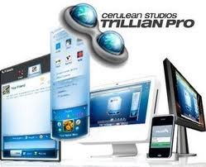

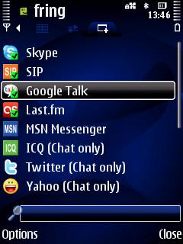
Electronic Communications
E-mail, Skype, ICQ, IRC, MSN Messenger, Yahoo Messenger, Social Networks, Forums, …

Slide 53
Question
What is the hashtag (#) used for when posting Tweets to Twitter?
It is used to mark keywords. This helps when searching for Tweets on particular topics.
It is used to indicate the username of the account from which the Tweet is being made.
It is used for replies or mentions, to indicate the name of another user.
It is used to indicate anger or annoyance.

Slide 54
Answer
Answer: A
The # symbol is used to mark keywords or topics in a Tweet. It was created organically by Twitter users as a way to categorize messages.
Information:
http://en.wikipedia.org/wiki/Twitter

Slide 55



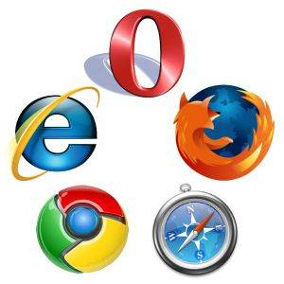
World Wide Web (WWW)
How does WWW work? Protocols HTTP, GET, POST, URL, Web Browser, Web Page, Web Site, …

Slide 56
Question
Which of the following web servers does not use threads to process HTTP requests?
Jigsaw
IIS
Tomcat
Apache
Nginx

Slide 57
Answer
Answer: E
Nginx is a HTTP server as well as an IMAP/POP3 proxy server.
Nginx uses an asynchronous event-driven approach to handling requests, instead of a threaded or process-oriented approach.
Information:
http://www.webdevelopersnotes.com/hosting/list_of_web_servers.php3
http://wiki.nginx.org/Main
http://en.wikipedia.org/wiki/Nginx

Slide 58




Web Design, HTML, CSS
Web Design, HTML, CSS, Text, Graphics, Crossing References, Tables, Blanks, …

Slide 59
Question
Which statement is true about the Responsive Web Designs:
The responsive designs are set to an overall fixed width that does not react to changes.
The responsive designs redirects to special mobile version of the web site.
The responsive designs layouts can change based on orientation, device type, screen size.
The responsive designs does not use media queries.

Slide 60
Answer
Answer: C
Responsive Design adapts the layout to the viewing environment by using fluid, proportion-based grids, flexible images, and CSS3 media queries, an extension of the @media rule.
Information:
http://en.wikipedia.org/wiki/Responsive_web_design
http://www.lynda.com/CSS-training-tutorials/447-0.html

Slide 61





JavaScript
Scripts Development with JavaScript, Main JavaScript Constructions, Operators, Objects, DOM Tree Manipulation

Slide 62
Question
Which jQuery function is used to prevent code from running, before the document is finished loading?
$(body).onload()
$(document).load()
$(“*”).ready()
$(document).ready()
$(body).load()

Slide 63
Answer
Answer: D
It is a good practice to wait for the document to be fully loaded and ready before working with it. This also allows you to have your JavaScript code before the body of your document, in the head section.
Information:
http://www.w3schools.com/jquery/default.asp

Slide 64
Telerik School Academy
?
?
?
?
?
Questions?
?
?
?
?
?
http://schoolacademy.telerik.com

